Slide 1
How Should We Text You? Designing and Testing Text Messages for the 2021-22 Teacher Follow-Up Survey (TFS) and Principal Follow-Up Survey (PFS)
Jonathan Katz, Kathleen Kephart, Jasmine Luck, and Jessica Holzberg
Center for Behavioral Science Methods U.S. Census Bureau
Federal Committee on Statistical Methodology (FCSM)
November 3, 2021
Disclaimer: This presentation is released to inform interested parties of research and to encourage discussion. The views expressed are those of the authors and not those of the U.S. Census Bureau.

Slide 2
Background
There is widespread interest in using text messaging as part of survey data collection
97% of Americans now own a cellphone
85% own a smartphone
Cellphone ownership is widespread across different demographic groups (Pew, 2021)

Slide 3
How can texting be used for data collection?
Option 1:
Use texting to send a web link
Respondent clicks link and completes web survey on their phone
Option 2:
Embed survey questions in SMS text messages
Respondent replies to text messages with responses

Slide 4
Challenges
List of good mobile phone numbers is not always available
Legal constraints around text messaging for those who have not opted into receiving messages
Length and type of survey questions that can be asked
Content must be 160 characters or less to fit in one SMS message
Potential user privacy concerns

Slide 5
Research Questions
Pilot test to evaluate feasibility of adding a text messaging mode to the survey data collection
How do participants perceive and interact with text messages containing survey questions or a survey link?
What features contribute to participants’ perceptions of text message surveys?
What contact methods do participants prefer?
What can we learn from cognitive/usability testing to inform best practices on designing text message surveys?

Slide 6
2021-22 Teacher Follow-Up Survey (TFS) and Principal Follow-Up Survey (PFS)
Conducted by the U.S. Census Bureau on behalf of the National Center for Education Statistics
TFS and PFS are follow-up surveys to the National Teacher and Principal Survey (NTPS) conducted the prior school year
Questions focus on teachers’ and principals’ retention and if they left the profession, the reasons why they left

Slide 7
2021-22 TFS/PFS (cont.)
In the NTPS, respondents are asked to consent to receive follow-up text messages
Allows for a unique opportunity to add a text messaging mode in the Teacher and Principal surveys
Text messaging will be part of larger contact and data collection strategy
Contacts: Mail, email, phone calls, texting
Data collection: Paper, web survey (TFS only), texting

Slide 8
Texting in Teacher/Principal
Teacher
Principal
Welcome Text
Welcome Text
Web Link
SMS
SMS
Reminders
Reminders

Slide 9
Welcome text

Slide 10
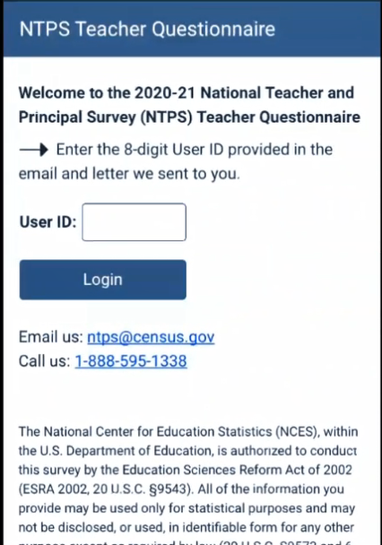
Web Link (Teacher only)

Slide 11
SMS

Slide 12
SMS (cont.)
 | Teacher | Principal
Number of Survey Questions | 2-7 | 1-5
Question Format | Yes/No | Yes/No

Slide 13
Reminder if no response is received

Slide 14
Methodology
Cognitive/usability testing conducted between December 2020 – February 2021 (n = 40)
Participants were teachers and principals
26 teachers and 14 principals across 21 different states
Conducted via Skype for Business/Microsoft Teams (mobile screensharing)
Text messages sent from the Qualtrics platform

Slide 15
Protocol
Prior to receiving text messages, participants were provided background on Teacher/Principal
Teachers administered both web link and SMS (order varied)
Principals administered only SMS
Observed participant interactions with the text messages to identify usability issues
Used combination of think aloud and retrospective probing questions. Participants were asked about:
Perceived legitimacy
How they would like to be contacted for this type of survey (e.g., text message, email, or mail)

Slide 17
Results: How do respondents perceive and interact with text messages containing survey questions?
Most participants seemed to like this method of answering survey questions
Easy to complete the survey in one screen
Did not have to go to a different web browser or mode
Liked that the survey was short
Only a few participants seemed to have an issue responding to survey questions via text message
Unsure what to do in the text message survey
Typing in an incorrect response

Slide 18
Typing in an incorrect response

Slide 19
How do respondents perceive and interact with a survey link?
Majority of teachers had positive feedback on the web link condition
Most were able to log into the test site with the User ID
A few participants mentioned the log-in task being more difficult than typing in the responses to the survey questions
Going back and forth between the text message and web page to type in the User ID
One participant mentioned they wished the User ID would auto-populate in the User ID field

Slide 20
What features contribute to participants’ perceptions of text message surveys?
Majority of participants thought the text message surveys were legitimate
The following helped with legitimacy:
Text message specified it came from the U.S. Department of Education and Census Bureau
The ‘usa.gov’ link for sponsor web site and the survey
Survey did not ask for personal information

Slide 21
What features contribute to participants’ perceptions of text message surveys? (cont.)
What may motivate participants to respond to the survey?
Needing to be contacted in other modes regarding the survey
Remembering the previous survey they had completed
Participants noted the following concerns
Survey invitation coming from a random phone number
Confusion about the meaning of “contacts”
Not liking the phrase “have messaged you multiple times” in a reminder message

Slide 22
What contact methods do participants prefer?
Majority of participants would prefer being contacted about the survey via email rather than text message
One participant preferred mail or email for a first contact
Another participant mentioned once they agreed to do the survey, they would prefer text message

Slide 23
What can we learn from cognitive/usability testing to inform best practices on designing text message surveys?
Cognitive and usability testing of text messages was successful in gathering feedback
Screensharing was invaluable for observing participants’ interactions
Participants’ feedback helped with:
Tailoring welcome/reminder messages
Assessing the feasibility of asking survey questions in SMS
Designing survey questions in SMS to ease burden
Determining when a text messaging mode would be optimal in data collection

Slide 24
Recommendations: General
Feasible to include a text messaging mode in survey data collection
Keep the length of the survey short
Include name of sponsor and link to the sponsor web page in text message

Slide 25
Recommendations: SMS surveys
Implement close-ended questions only
Design the survey questions so they can be answered by only typing no more than a couple characters
Ensure the platform can process the response in multiple ways
“1”
“Yes”
“1. Yes.”

Slide 26
Recommendations: Embedded survey link
Allow log-in code/User ID to autofill in the log-in page for the web survey link
Or provide unique survey link

Slide 27
Future Research
When and how to implement texting
Current plan for the 2021-22 Teacher/Principal surveys is to distribute text message, mail, and email around the same time
Plan to conduct an A/B experiment in Teacher on when to distribute a survey via text message
How to handle longer surveys
Conduct an A/B experiment of a short survey versus long survey via SMS

Slide 28
Thank you! jonathan.m.katz@census.gov

Slide 29
References
Pew Research Center. (2021). Mobile fact sheet [Fact sheet]. http://www.pewresearch.org/internet/fact-sheet/mobile/

